Slide 1

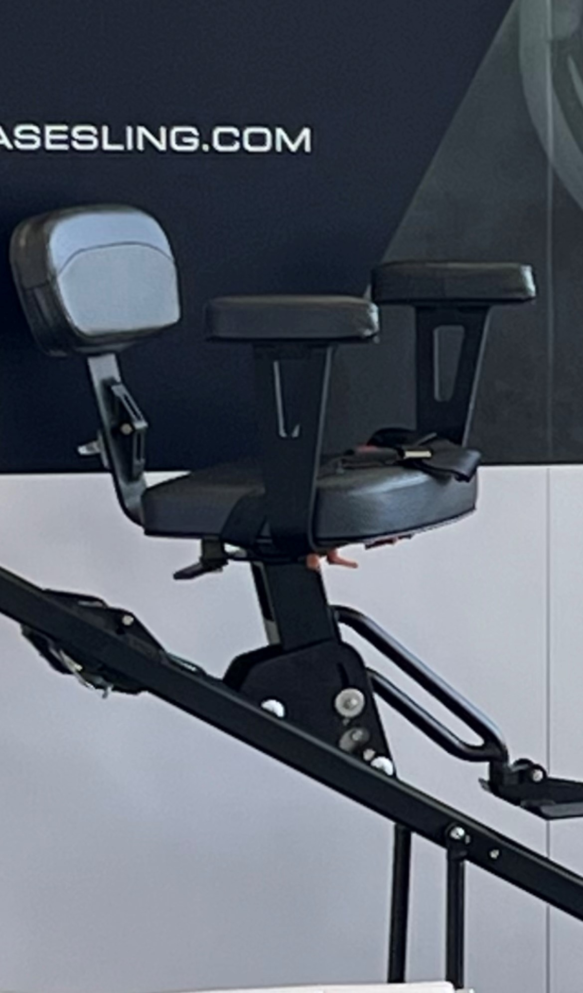

&
2026

Slide 2

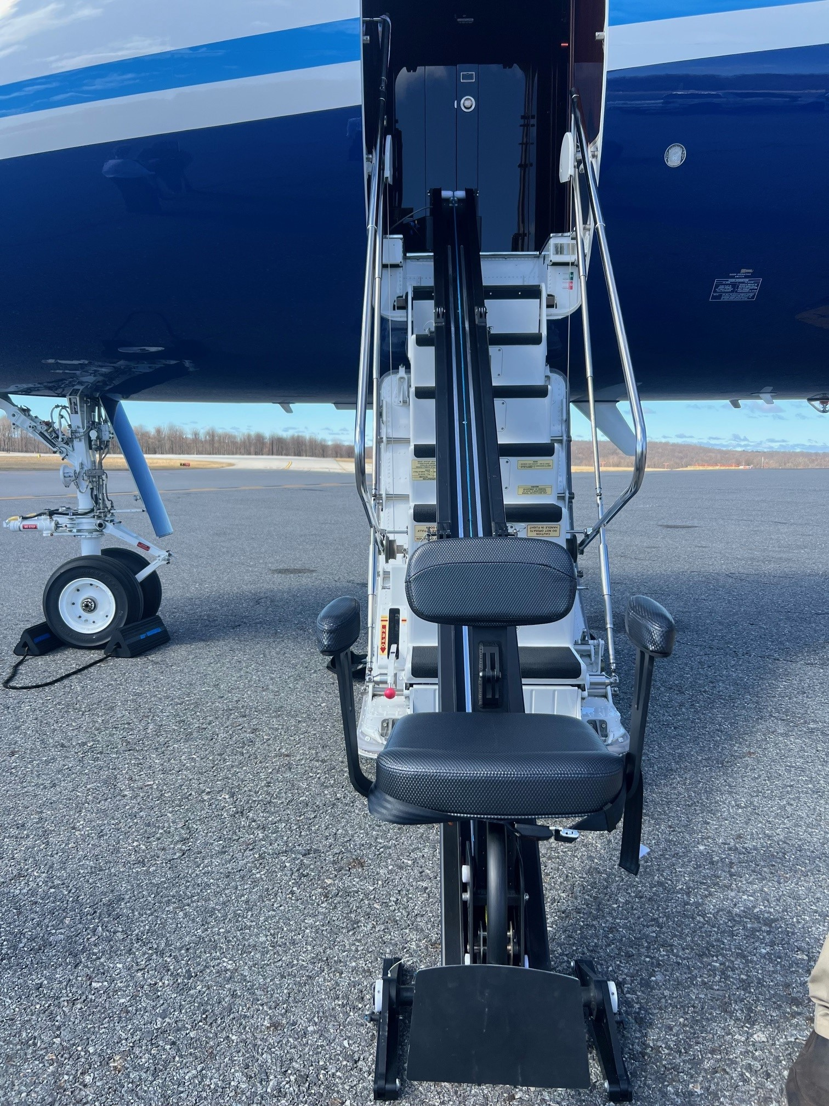
The AeroChair™ | Product
  Product
  3 - 4 minutes to assemble & disassemble
  No STC
  Loose Equipment
  No weight placed on door
  Portable, Stow on-board to use on road
  Adaptable to nearly any aircraft make/model
  350 lb weight limit - our posted limit to follow FAA guidelines. Tested and capable of 500lbs
  Patented

Slide 3
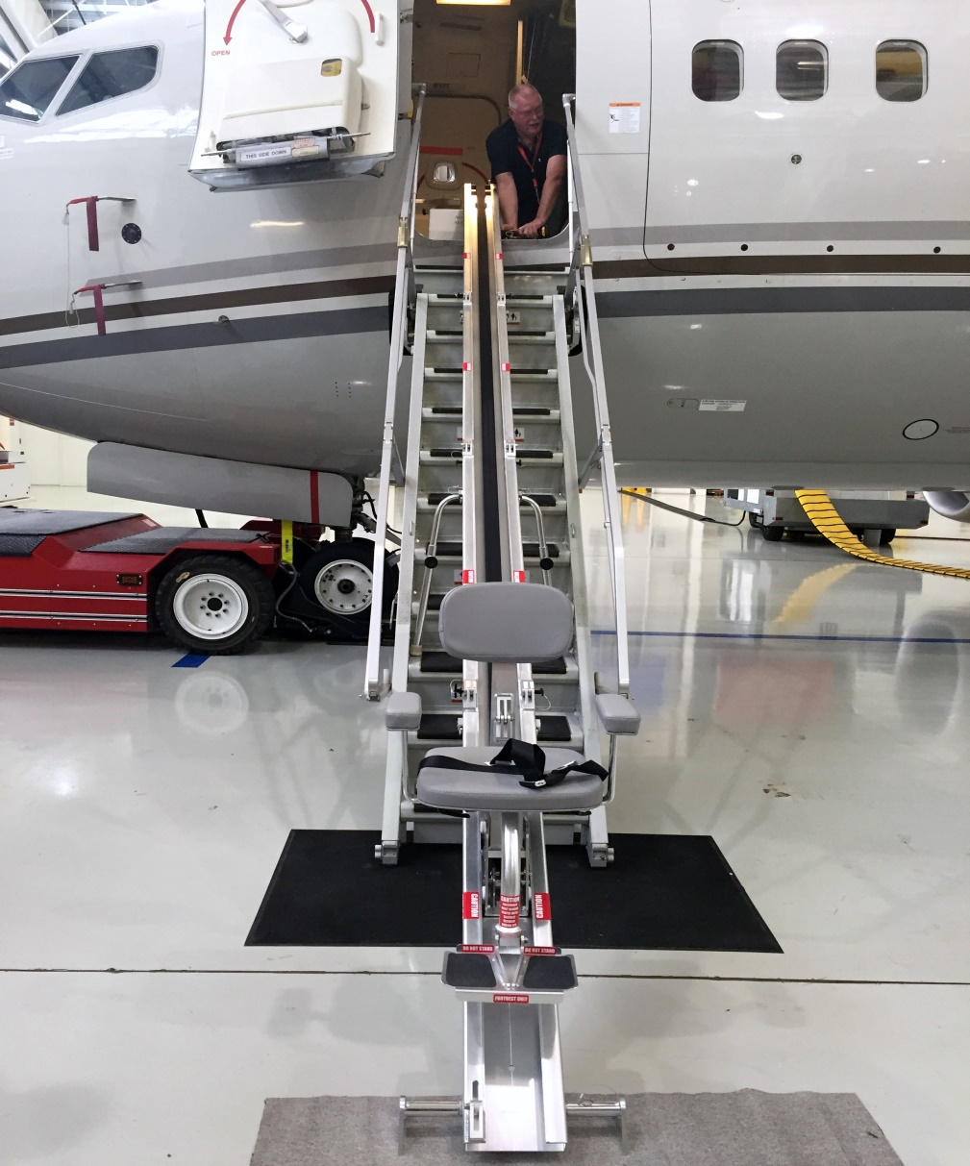
The AeroChair™ | Product
  Product
  3 - 4 minutes to assemble & disassemble
  No STC
  Loose Equipment
  No weight placed on door
  Portable, Stow on-board to use on road
  Adaptable to nearly any aircraft make/model
  350 lb weight limit - our posted limit to follow FAA guidelines. Tested and capable of 500lbs
  Patented

Slide 4

The AeroChair™ | Aircraft Compatibility List
  Boeing
    BBJ
  Bombardier
    Global Series
    Global 7500, 8000
    Challenger 300, 600 series
  Cessna
    Citation XLS
    Citation X, Sovereign
  Dassault Falcon
    Falcon 20 & 50 series
    Falcon 900 & 2000 series
    Falcon 6X, 7X, 8X
    Falcon 10X
  Embraer
    Lineage
    Legacy series
    Phenom 300
    Praetor 600
  Beechcraft
    Select King Air models
  Gulfstream
    G200, G280, G400
    GIV, GV, G550, G650
    G500, G600
    G700, G800
  Pilatus
    PC-12
    PC24

Slide 5
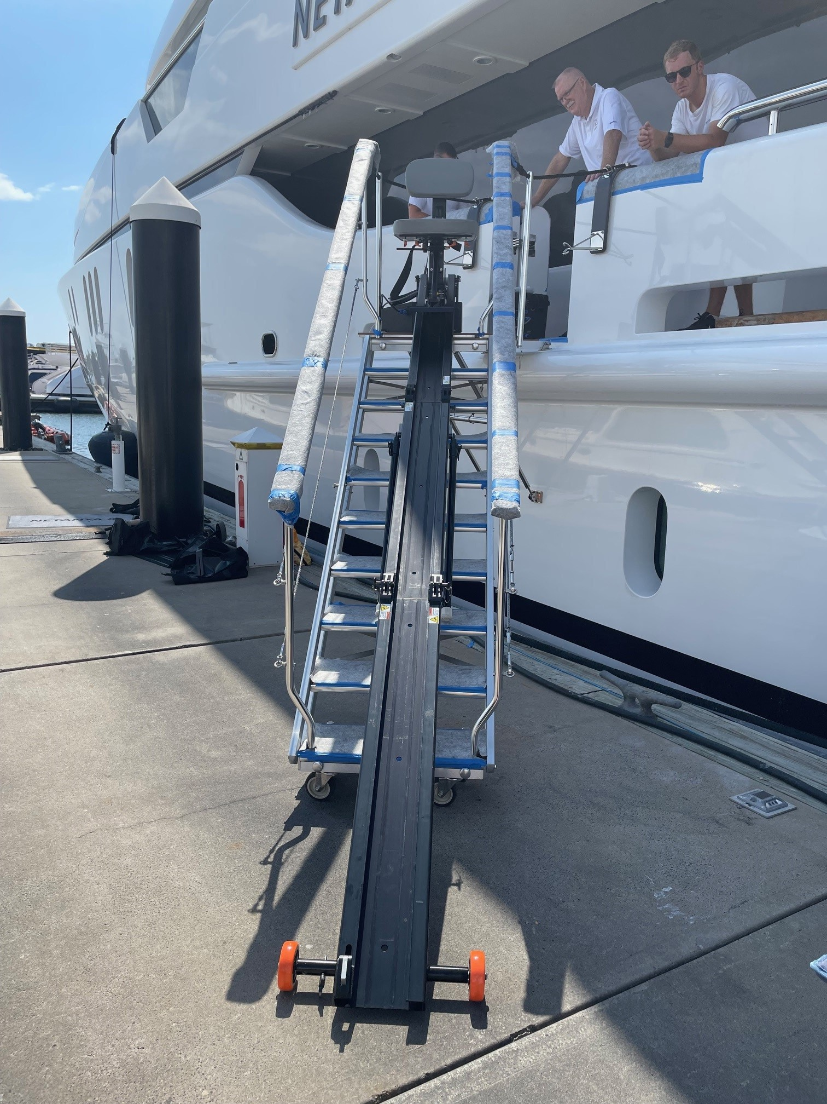
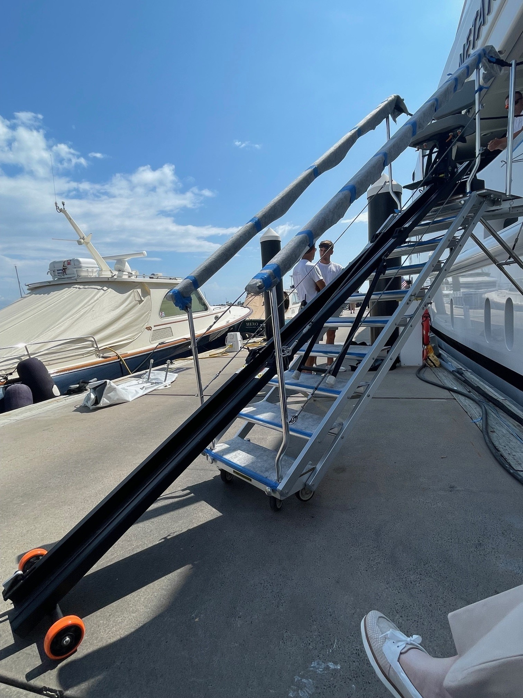
The AeroChair™ | Boat Application

Slide 6
  The AeroChair is comprised of 5 Components
1. Battery Box 19 lbs 7”H x 11”D x 12”W
2. Motor 55 lbs 14”H x 10”D x 1”W
3. Trolley 12 lbs 13”H x 19”D x 15”W
4. Chair 20 lbs 12”H x 19”D x 23”W
5. Track 56 lbs 51” L (tri-fold) / 150” L (extended)
162 lbs
Additional Track Sizes
b. Lights 45lbs 45” L (bi-fold) / 132” L (extended)
c. BBJ 94lbs 68” L (tri-fold) / 264” L (extended)
The AeroChair™ | Pax Lift Components

Slide 7
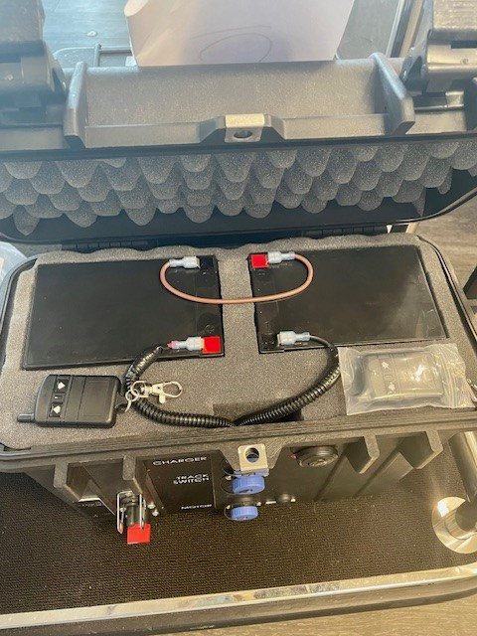
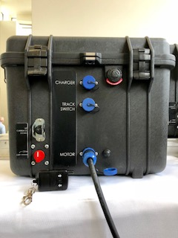
The AeroChair™ | Battery Pack
  Battery
  2 - 12Volt, Sealed, Lead Acid Batteries
  Non-Lithium, Non-Spill battery
  49CFR 173.159a Exceptions for Non-Spillable Batteries
  Integrated controls housed in durable, pelican case
  Remote Control Operated (2 remotes provided)
  Manual Switch to operate without a remote control
  Total Weight: 19 lbs
  Dimensions: 7”H x 11”D x 12”W

Slide 8
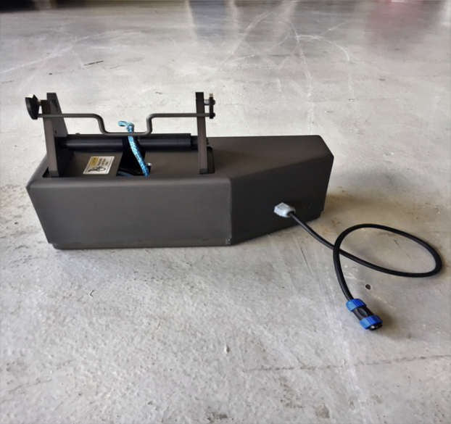
The AeroChair™ | Motor Drive Unit
Motor Drive Unit
  Motor Drive Unit
  Direct Drive Motor
  Quick Cam-lock attachment (to house track)
  Proximity Switch to control up movement
  Amsteel Blue 1/4” rope certified for 5,400lb
  tow Certificate Provided
  Wireless, hand-held remote
  Manual Switch
  Total Weight: 55 lbs
  Dimensions: 14”H x 10”D x 1”W

Slide 9
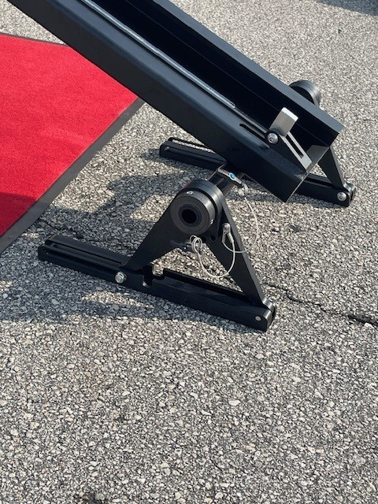
The AeroChair™ | TRACK
Track
  TRACK
  Custom Extruded for maximum strength
  Anodized Finish for durability
  Tri-Fold
  Quick Cam-lock attachment (to house track)
    Adjustable Stability Bar for extra comfort
            Adjustable Feet for ideal pitch
Aircraft Unfolded Height Width L Tri-Folded Weight
Heavy 150” 12” 15” 51” 56 lbs
Mids 132” 12” 15” 45” 45 lbs
BBJ 264” 16” 15” 68” 94 lbs
*Measurements are approximate and subject to verification

Slide 10
The AeroChair™ | Trolley Base & Chair
  Trolley Base
  Wheels contained within the channels track
  Positions the chair to maintain a level ride
  Allows chair to unlock and swivel for easy entry & exit
  Total Weight: 12lbs
  Dimensions: 13”H x 19”D x 15”W
  Trolly Base: Specific to Passenger Lift
  Chair
  Adjustable & Quickly Removable armrests
  Seat back hinges & folds for ease of storage
  Chair locks into place at 90, 135, 180 degrees
  Total Weight: 20lbs
  Dimensions: 12”H x 19”D x 23”W

Slide 11
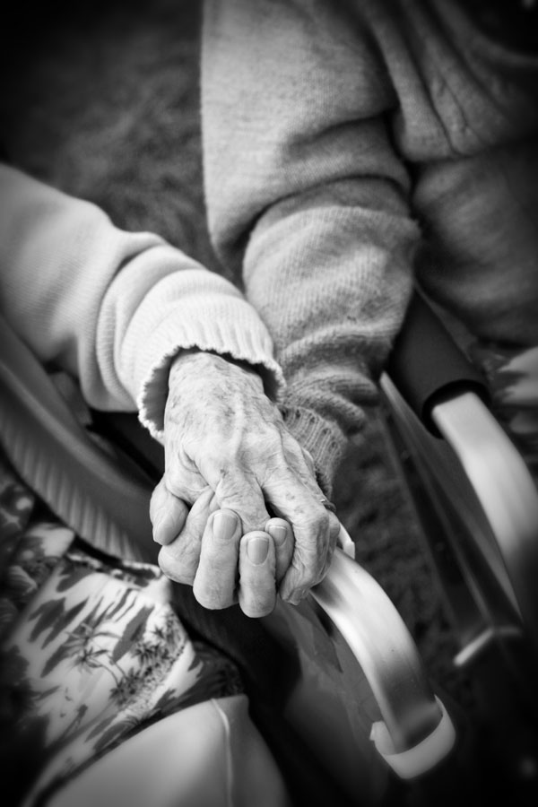
The AeroChair™ | COST
Light-Heavy
Aircraft $104,700. includes bags & spares package
Custom Canvas Bags $6,000. (1 set included in purchase price)
Spares Package $7,000. (1 set included in purchase price)
Spare Track $20,000.
BBJ Track $35,000.
Build Time Appx 12 - 16 weeks
Spares Package includes: (1) Battery Pack Unit, (2) Remote Controls,
Pins & Lanyards
Due to supply chain interruptions our delivery
estimates are subject to change.
Investment

Slide 12
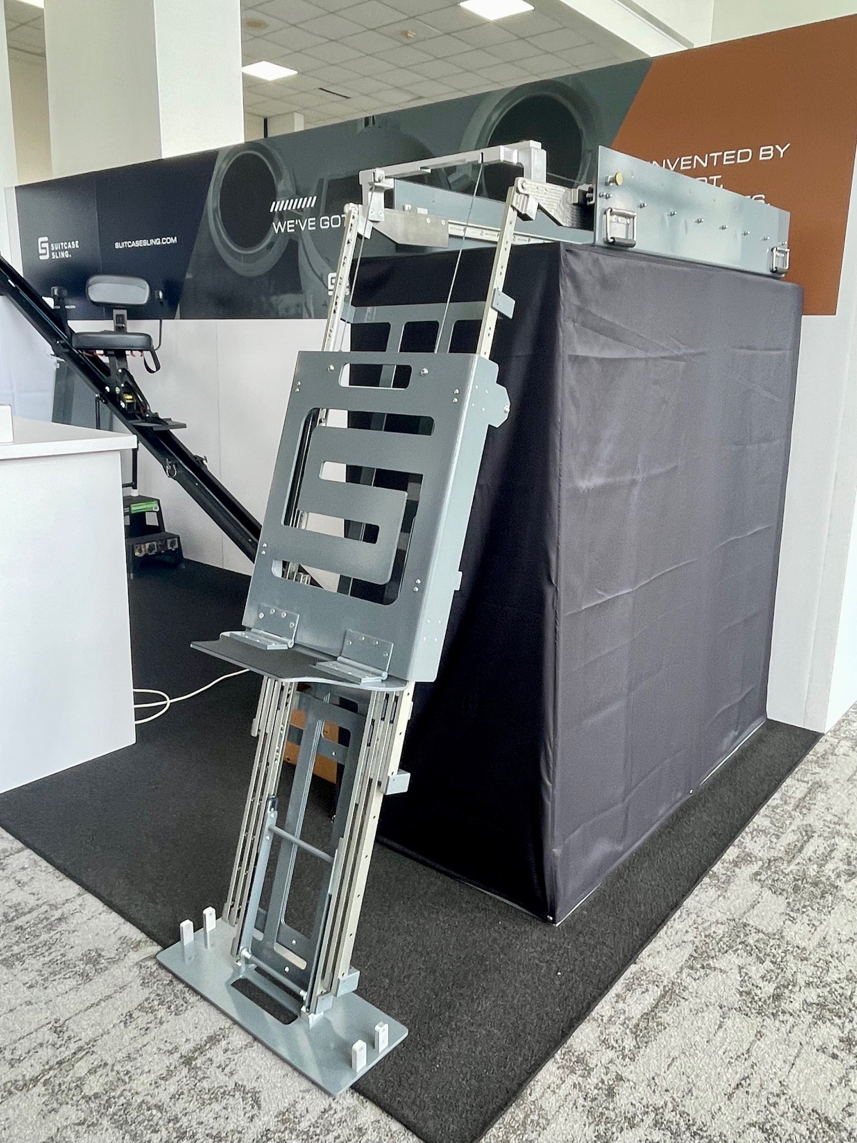
Suitcase Sling™™
  Airplanes are getting taller. Bags are getting Heavier.
Suitcase Sling™ (Patent Pending) is a light, easy-to-store-and-deploy, loose-equipment solution designed by flight crew for flight crews, to help prevent Injuries and expedite the baggage loading/unloading process.
become easier, faster and safer than ever before.
NOTE: MODEL SHOWN IS MORE ROBUST, FOR MILITARY APPLICATION
BIZAV MODEL LIGHTWEIGHT & LOWER PROFILE

Slide 13
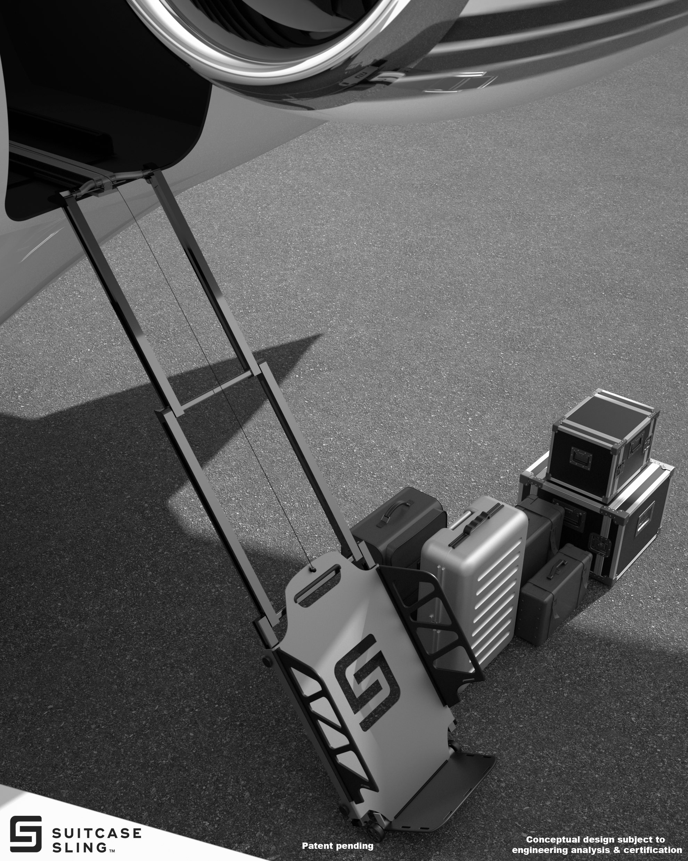

Slide 14
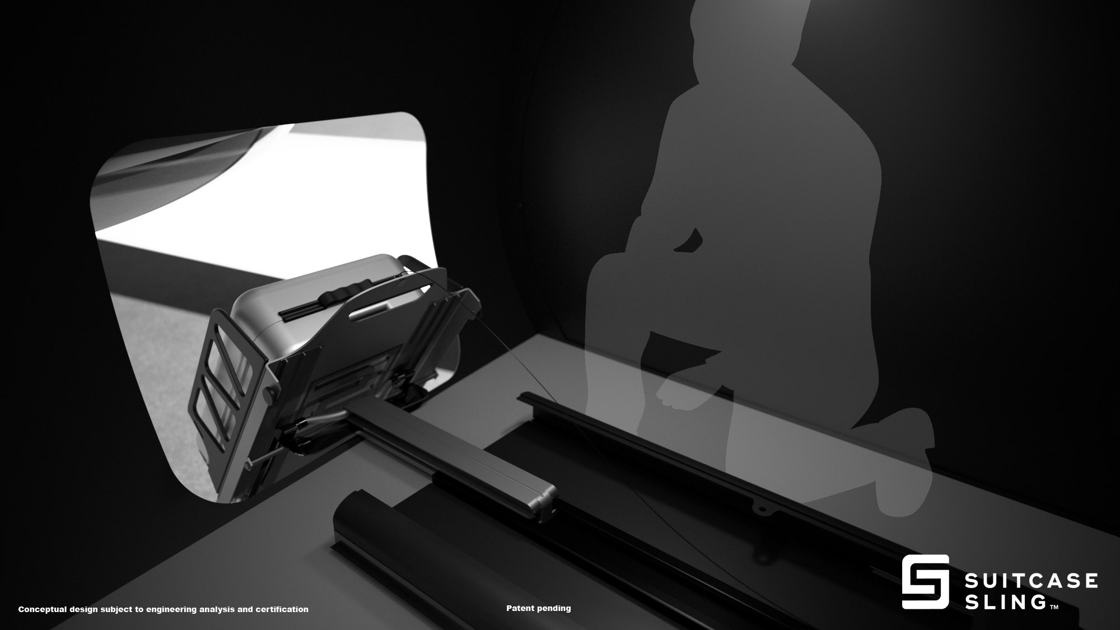
The AeroChair™ | Proposed Wheelchair Attachment

Slide 15
CONTACT
Aimee Weaver
Director of Sales & Marketing
M: 561-254-4101
aimee@airstairsolutions.com
aimee@suitcasesling.com
PO Box 31849, Palm Beach Gardens, FL 33420

